Slide 1






Samuel Spencer Final Project: Oral Defense
A, B, C, and D are sets
Problem a. Given: A $∩$ B $⊆$ C $\backslash$ D
$, x∈$ B
$, x∈$ A
We will prove that if $x$ $∈$ A and $x$ $∈$ D, then $x∉$ B.
Contrapositive: if $x∈$ B, then $x∉$ A or $x∉$ D
{
$$¬p∨q≡p→q$$
Assume
$$¬p∨¬q≡p→¬q$$
Logically Equivalent: if $x∈$ B, then if $x∈$ A then $x∉$ D
{
Assume

Slide 2
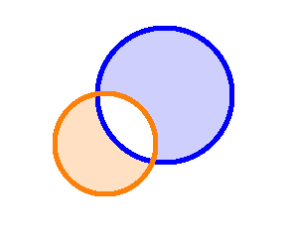
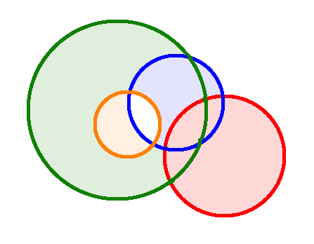
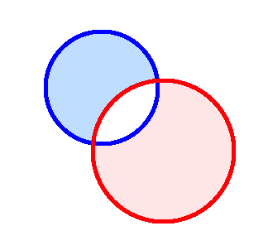
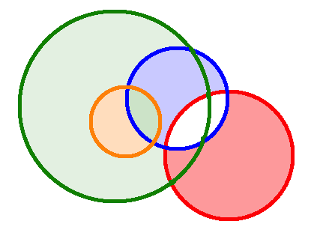

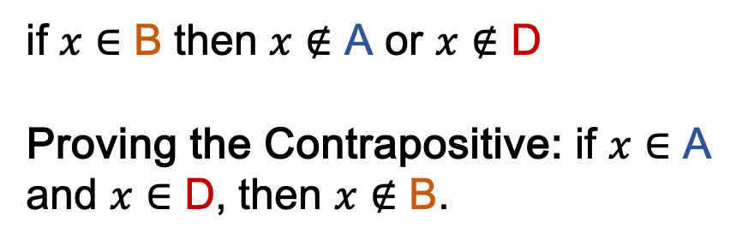


















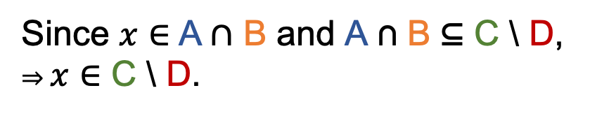

Problem a. Given: A $∩$ B $⊆$ C $\backslash$ D
$, x∈$ B
$, x∈$ A
$$x$$
$$\text{A}$$
Proof: Since $x∈$ A and $x∈$ B, $then x∈\text{A}∩\text{B}$
$$\text{A} \text{B}$$
$$x$$
$$\text{B}$$
$$\text{A}∩\text{B}$$
Since $x∈$A$∩$ B and A ∩ B ⊆ C \ D,
⇒ $x∈$ C \ D.
$$x$$
C
$$\text{A}$$
C \ D
$$x$$
$$\text{B}$$
Since $x∈$ C \ D then it follows that $x∉$ D
D
$∴$
if $x∈$ B then $x∉$ A or $x∉$ D
Proving the Contrapositive: if $x$ $∈$ A and $x$ $∈$ D, then $x∉$ B.
$∴$
$$\text{A}$$
C
$$\text{A}$$
$$x$$
$$x$$
D
$$\text{B}$$
D

Slide 3
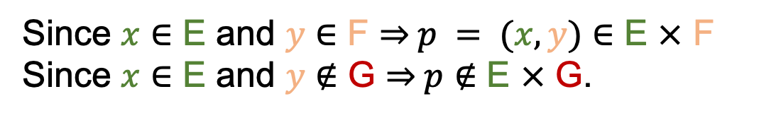



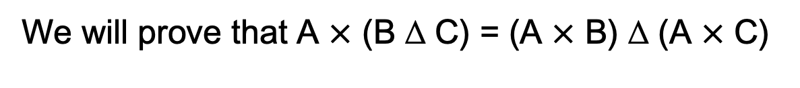
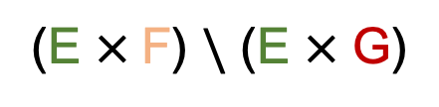







A, B, C, and D are sets
… and E, F, and G are sets
Problem b.
We will prove that A $×$ (B ∆ C) = (A $×$ B) ∆ (A $×$ C)
First we will show E $×$ (F $\backslash$ G) $=$ (E $×$ F) $\backslash$ (E $×$ G)
$$p = (x, y)$$
Say $p = (x, y)$ $∈$ E $×$ F $\backslash$ G
$$p$$
E $×$ F $\backslash$ G
Since $y∈$ F $\backslash$ G ⇒ $y$ $∈$ F and $y∉$ G
Since $x∈$ E and $y∈$ F ⇒ $p = (x, y)$ $∈$ E $×$ F
Since $x∈$ E and $y∉$ G ⇒ $p∉$ E $×$ G.
$$p = (x, y)$$
$$p = (x, y)$$
$$p$$
$$p$$
E $×$ F
E $×$ G
$$p$$
$∴p∈$ (E $×$F) $\backslash$ (E $×$ G)
$∴\text{E} ×\text{ (}\text{F} \backslash \text{G}\text{)}$ $⊆$ (E $×$F) $\backslash$ (E $×$ G)
$$p$$
(E $×$F) $\backslash$ (E $×$ G)

Slide 4












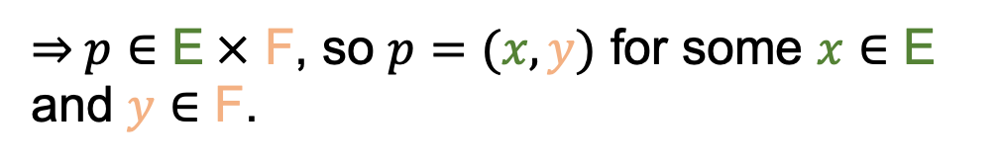


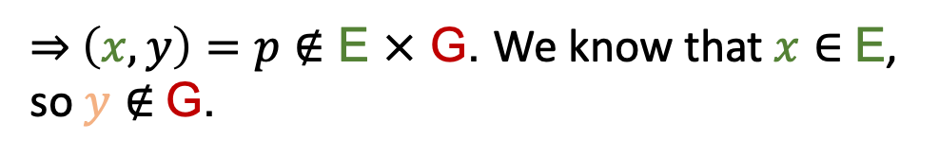

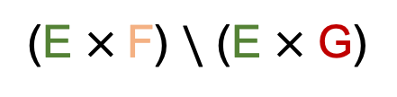



Problem b.
$$p$$
Now let $p∈$ (E $×$F) $\backslash$ (E $×$ G).
$$p$$
(E $×$F) $\backslash$ (E $×$ G)
$\text{⇒} p∈$ E$×$ F, so $p=$ $(x,y)$ for some $x∈$ E and $y∈$ F.
$$p = (x, y)$$
$$p$$
E $×$ F
$\text{⇒} \left(x,y\right)=p∉$ E $×$ G. We know that $x∈$ E, so $y∉$ G.
$$p = (x, y)$$
$$p$$
E $×$ G
Since $y∈$ F and $y∉$ G, $y∈$ F $\backslash$ G.
$$y$$
$∴ p=\left(x,y\right)∈$ E $×$ (F $\backslash$ G).
$$y$$
F $\backslash$ G
$∴$ (E $×$ F) $\backslash$ (E $×$ G) $⊆$ E $×$ (F $\backslash$ G).
$$p = (x, y)$$
$$p$$
E $×$ F $\backslash$ G
$∴\text{E} ×\text{ (}\text{F} \backslash \text{G}\text{)}$ $=$ (E $×$F) $\backslash$ (E $×$ G)

Slide 5




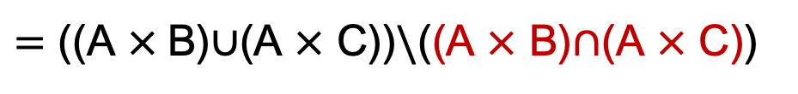
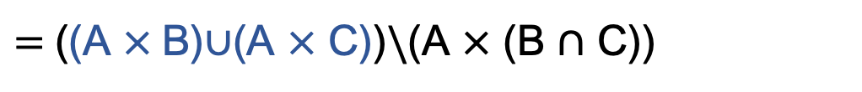
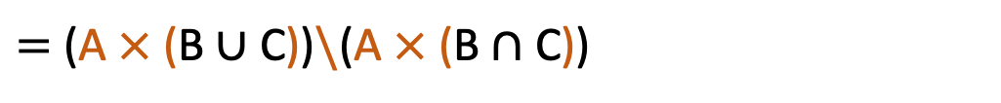

Problem b.
A $×$ (B $Δ$ C).
-Left-hand side of the equation in the theorem.
$=$ A $×$ ((B $∪$ C)$\backslash$(B $∩$ C))
-Definition of a Symmetric Difference.
$=$ (A $×$ (B $∪$ C))$\backslash$(A $×$ (B $∩$ C))
-Using what we just proved about E, F, and G to distribute a Cartesian Product across a Set Difference.
$=$((A $×$B)$∪$(A $×$ C))$\backslash$(A $×$ (B $∩$ C))
-Property of Cartesian Product Distributed over Union.
$=$ ((A $×$B)$∪$(A $×$ C))$\backslash$((A $×$ B)$∩$(A $×$ C))
-Property of Cartesian Product Distributed over Intersection.
(A $×$ B) ∆ (A $×$ C)
-Right-hand side of the equation in the theorem.
$=$((A $×$ B)$∪$(A $×$ C))$\backslash$((A$×$ B)$∩$(A $×$ C))
-Definition of a Symmetric Difference.
A $×$ (B ∆ C) = (A $×$ B) ∆ (A $×$ C).
-Both sides of the equation equal the same thing.

